Slide 1
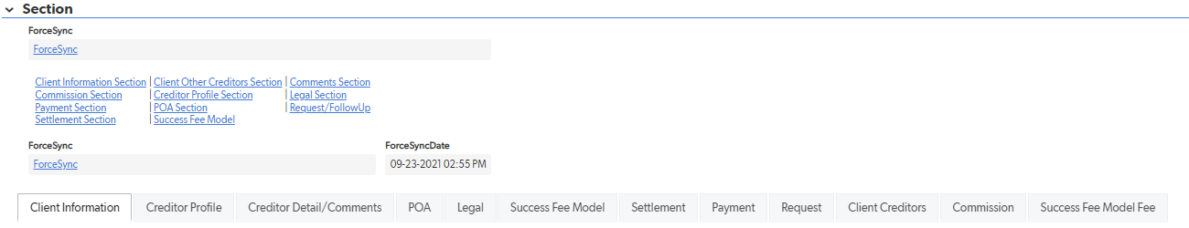

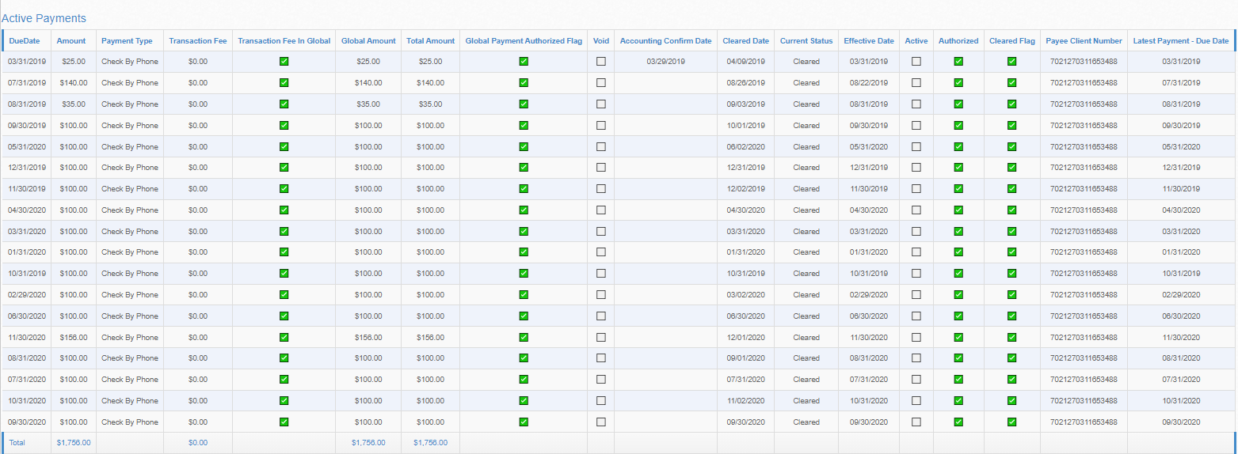
How to View Paid in Full Creditor Payments
1. View the specific creditor page
2. Select Creditor Detail/Comments tab
3. Scroll all the way down to the bottom and Click the “Creditor Payments (Popup) link
4. From there you can view the Active Payments table that shows every payment that cleared Global to the creditor.
Notes:
Enrollments were down to $61MM in December from $81MM in November
Internal (non-affiliate) enrollments of $46MM were 23% below forecast ($60MM)
Drivers include macro factors: holiday seasonality, covid increases, stimulus allowing customers to put off decisions
Internally we are observing it is harder to reach customers, lower P2 rates, and lower close rates

